Slide 1

HACKATHON FOR PEACE, JUSTICE AND SECURITY
TEAM: WHAT_THE_HACK
JUNE 16th 2019

Slide 2
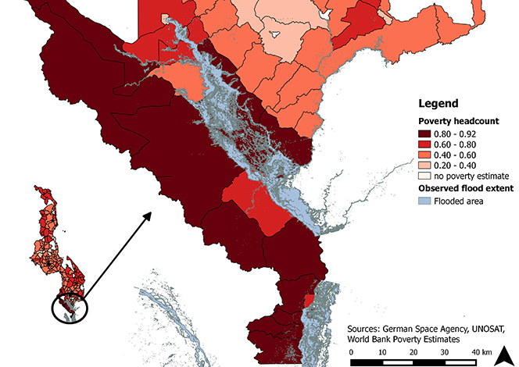

Slide 3





Communication
Use cases

Slide 4
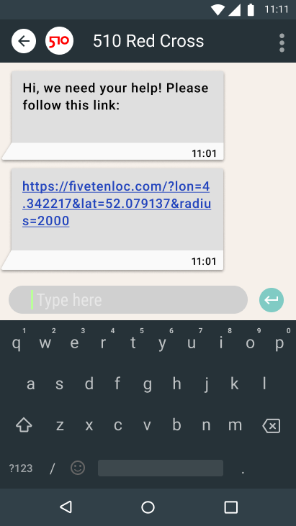
Response flow

Slide 5
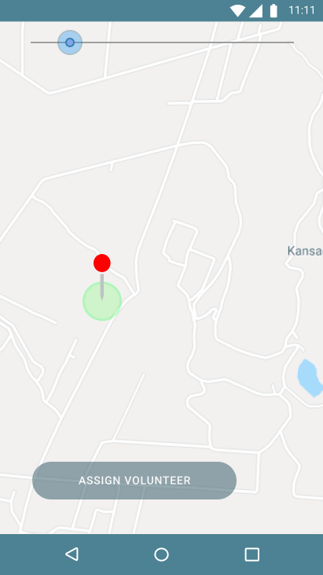
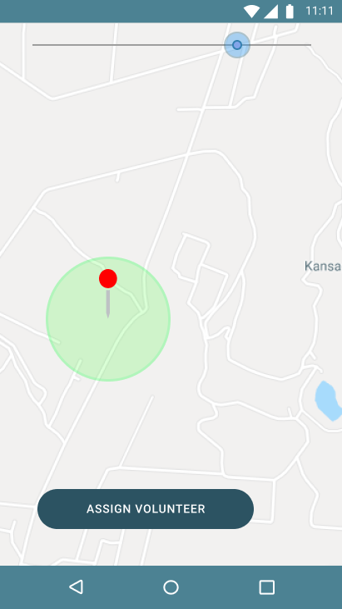
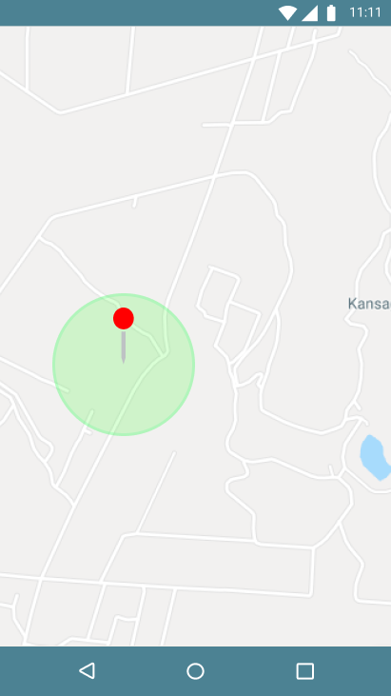
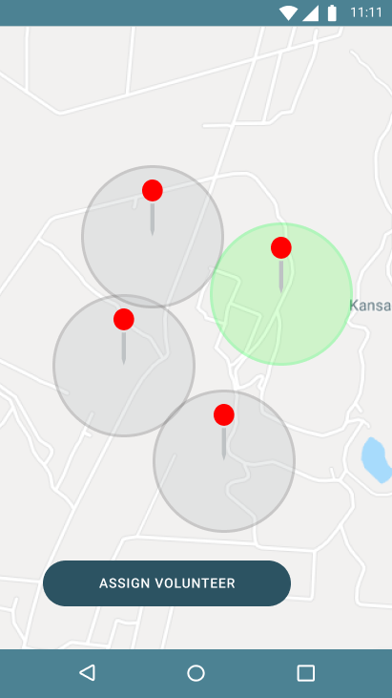
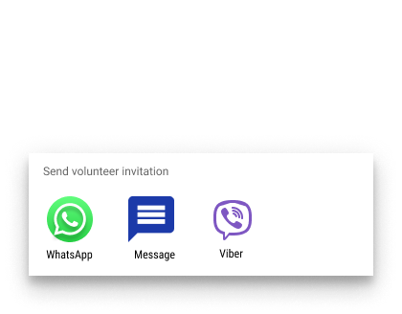
Local coordinator

Slide 6
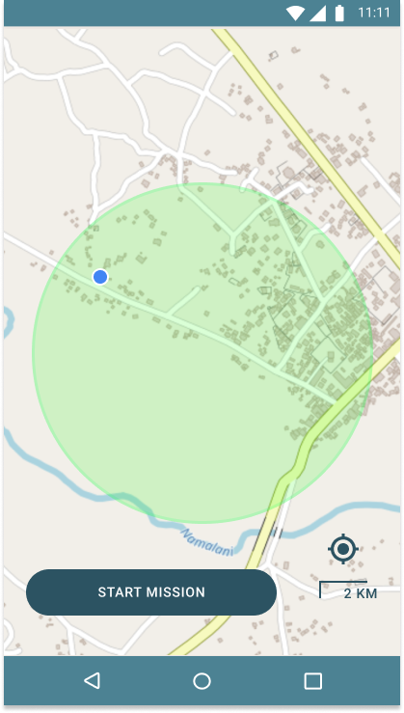
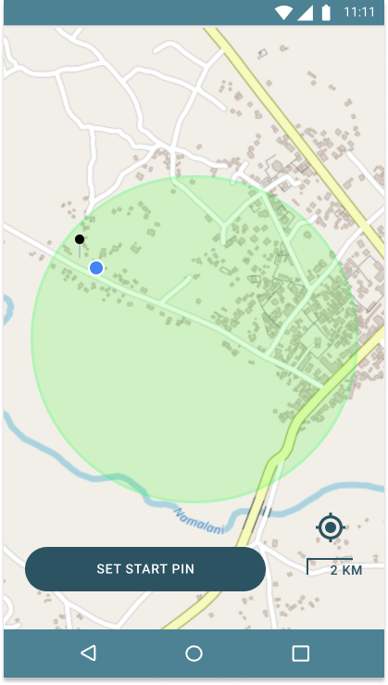

Volunteer mission

Slide 7
Existing habits
No internet, no worry
One product, multiple solutions

Slide 8
HACKATHON FOR PEACE, JUSTICE AND SECURITY
TEAM: WHAT_THE_HACK
JUNE 16th 2019

